Slide 1
Question:
What is the most cost-effective way to make clinical discovery faster, cheaper, and more precise?
Notes:
Lowering friction between data sources, digital health businesses, and patients to improve health outcomes faster, cheaper and better.
trust enabler - patients trust sharing their data, researchers trust integrity of data, digital health trusts effectiveness
Brian Kennedy
Eli: As a general comment, we're on a good path. What we should be inspired by and adapt it to serve us best: this is the OG sequoia pitch deck
Get inspiration from: https://visme.co/blog/best-pitch-decks/
Steal some design ideas: https://www.openvc.app/opendeck.php
Except for a couple of outliers, all decks are super simple.
So this is our PROBLEM SLIDE We're doing well on this slide, although, why "inflammation"? ​People are suffering from undiagnosed or hard-to-diagnose diseases, sure. And these may have to do with inflammation in most cases. However, if we start with "inflammation", we should continue with that theme throughout, otherwise, people will continue to wonder where inflammation comes into play again until the end of the deck.

Slide 2
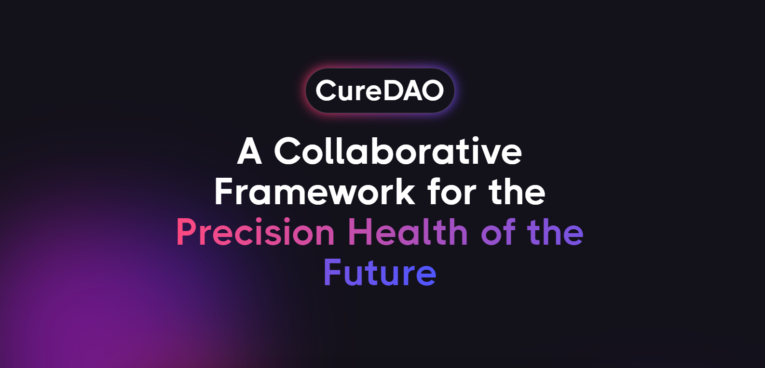

A Community-Owned
And Governed
Platform for
Accelerating Clinical Discovery
Notes:
Lowering friction between data sources, digital health businesses, and patients to improve health outcomes faster, cheaper and better.
trust enabler - patients trust sharing their data, researchers trust integrity of data, digital health trusts effectiveness
Brian Kennedy
Eli: As a general comment, we're on a good path. What we should be inspired by and adapt it to serve us best: this is the OG sequoia pitch deck
Get inspiration from: https://visme.co/blog/best-pitch-decks/
Steal some design ideas: https://www.openvc.app/opendeck.php
Except for a couple of outliers, all decks are super simple.
So this is our PROBLEM SLIDE We're doing well on this slide, although, why "inflammation"? ​People are suffering from undiagnosed or hard-to-diagnose diseases, sure. And these may have to do with inflammation in most cases. However, if we start with "inflammation", we should continue with that theme throughout, otherwise, people will continue to wonder where inflammation comes into play again until the end of the deck.

Slide 3

2 billion people suffer from inflammation-mediated diseases.
Symptom severity is influenced by hundreds of unknown factors in life.
Notes:
One significant cause…
Brian Kennedy
Eli: As a general comment, we're on a good path. What we should be inspired by and adapt it to serve us best: this is the OG sequoia pitch deck
Get inspiration from: https://visme.co/blog/best-pitch-decks/
Steal some design ideas: https://www.openvc.app/opendeck.php
Except for a couple of outliers, all decks are super simple.
So this is our PROBLEM SLIDE We're doing well on this slide, although, why "inflammation"? ​People are suffering from undiagnosed or hard-to-diagnose diseases, sure. And these may have to do with inflammation in most cases. However, if we start with "inflammation", we should continue with that theme throughout, otherwise, people will continue to wonder where inflammation comes into play again until the end of the deck.

Slide 4
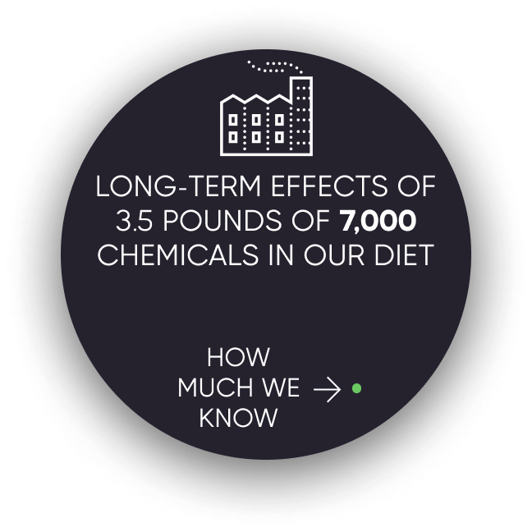
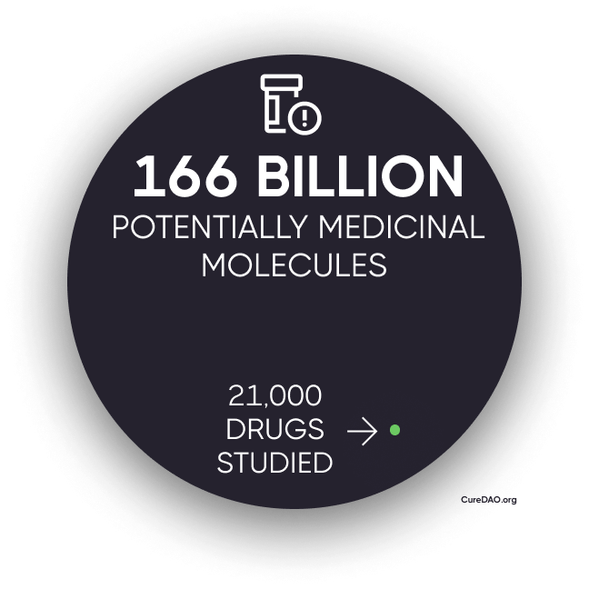
Due to the high cost of research, we know very a tiny fraction of what is left to be discovered.
Notes:
E: This is our second PROBLEM slide. Can we combine both in one single slide? E.G. https://imgur.com/dJ0sHQe
E: For every slide, we should have a single message the audience will take home. What's the message for our PROBLEM slide?
E:
1) Almost every second person on Earth suffers from non-communicable diseases caused by things we eat, breathe, and drink. These cause various forms of inflammation and are thus hard to diagnose and often remain undiagnosed.
2) Modern diet and urban life cause us to ingest and otherwise be exposed to 3.5 lbs of 7k chemicals per year (?) we would not be just 100 years ago, let alone if we lived as our ancestors and what our immune system evolved to tolerate. We do not know the long-term effects of the vast majority of those chemicals.
3) We do not know, because this is how the pharma system incentives work. Clinical trials are expensive, and drugs need a "target". (we need a much better point here!)
E: Let's think: what are we solving here? Is it the shitty drug dev system? Is it the non-sharing of data? Whatever it is, this needs to be our "theme" and it needs to be clear how everything we're doing contributes to the solution in every slide. -

Slide 5
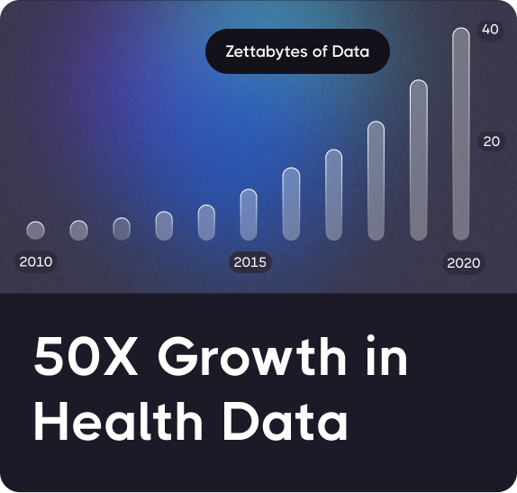
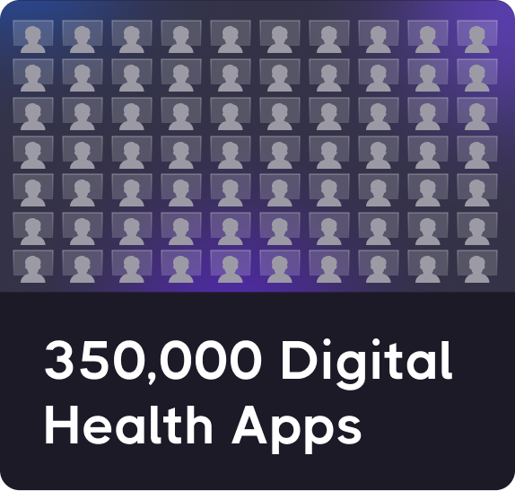
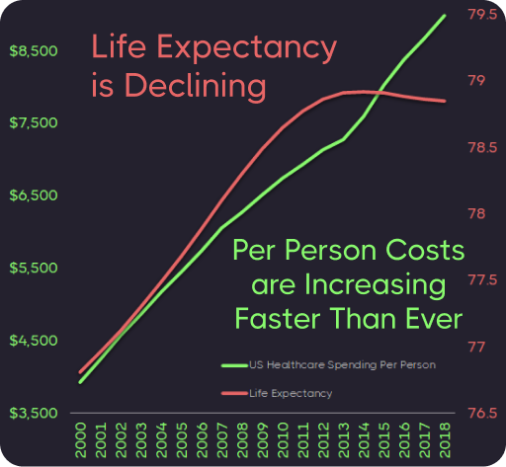
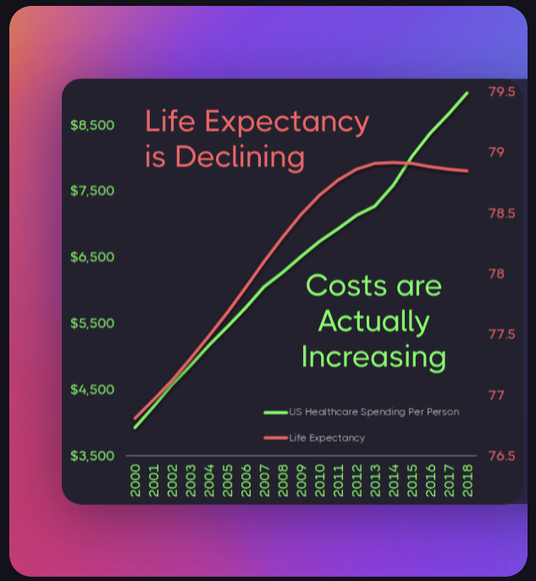
Q: Why hasn’t an explosion in health data and innovation led to improvement in lifespan or cost?
+
=
Notes:
E: While the point this slide makes a good point, does it contribute to our explanation of the main problem we are tackling, or is it just adding to it? If we ask Why hasn’t an explosion in health data and innovation led to improvement in lifespan or cost?, the answer cannot be: Collaboration & Data Sharing is Punished by the Market
E: It just does not make immediate sense, and it must (you will have the chance to pitch to a fraction of the people that will read your deck).
If we had 350k programmers working on this, are you seriously saying their problem was they did not have enough data?
Their companies raised and spent 157bn? And they failed because there was not enough data?
So....how do you think you'll be successful? The problem seems insurmountable.
If the market punishes sharing, why do you think the market is not going to chew up your little organization just like it did the QS giants?

Slide 6
Answer: Collaboration & Data Sharing
is Punished by the Market
We’re wasting $157 billion paying over 350,000 programmers to write the same code to implement the same basic functionality.
Horizontal Stagnation
Notes:
The free-rider problem and the tragedy of the commons punish any individual company that open sources its code
E: See comment for slide above. I'd get rid of this or combine it into one slide and put it into supplementary slides.

Slide 7
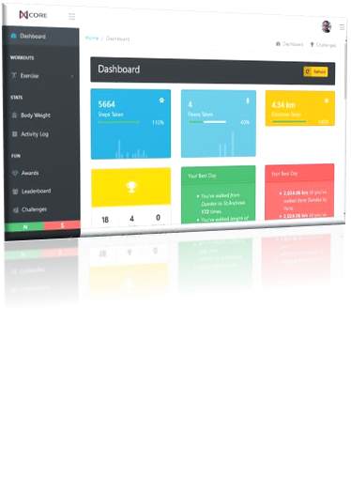
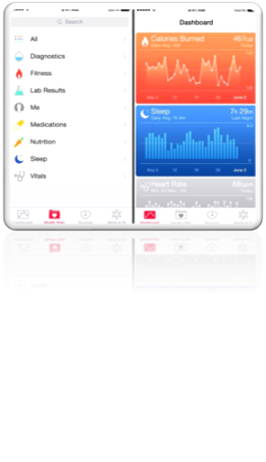
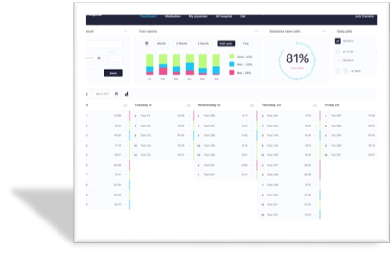
We Have Thousands of
Dashboards Telling Us What We Have Done, But Not What We Should Do
Notes:
E: Supplementary deck

Slide 8
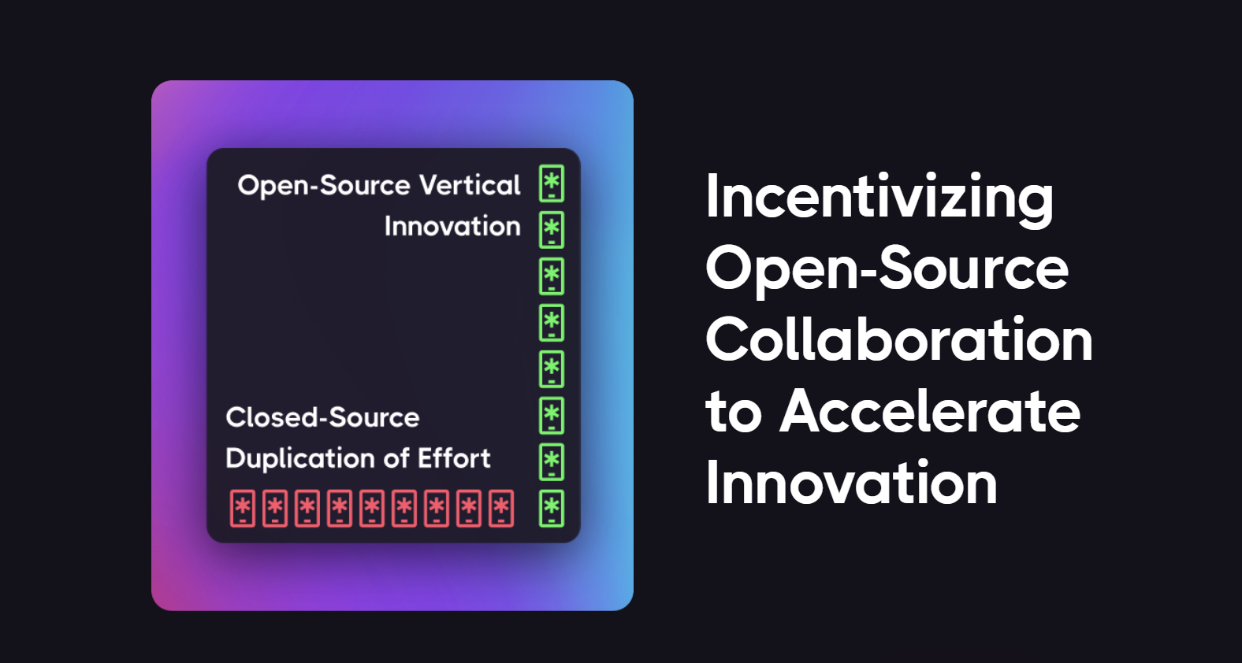
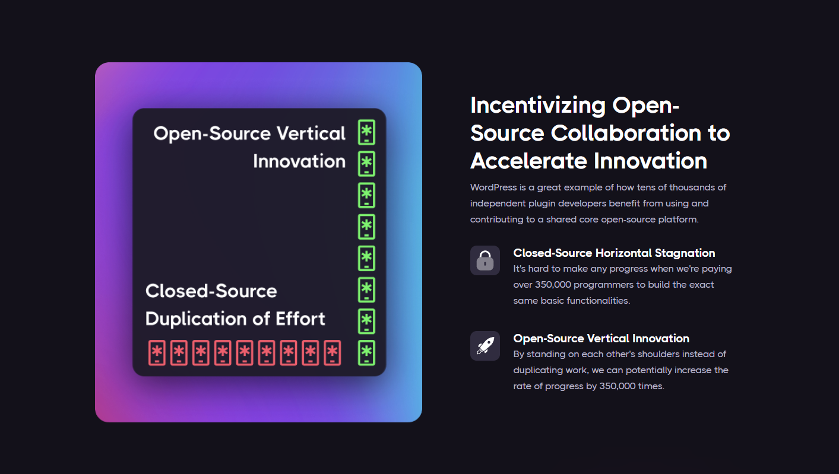
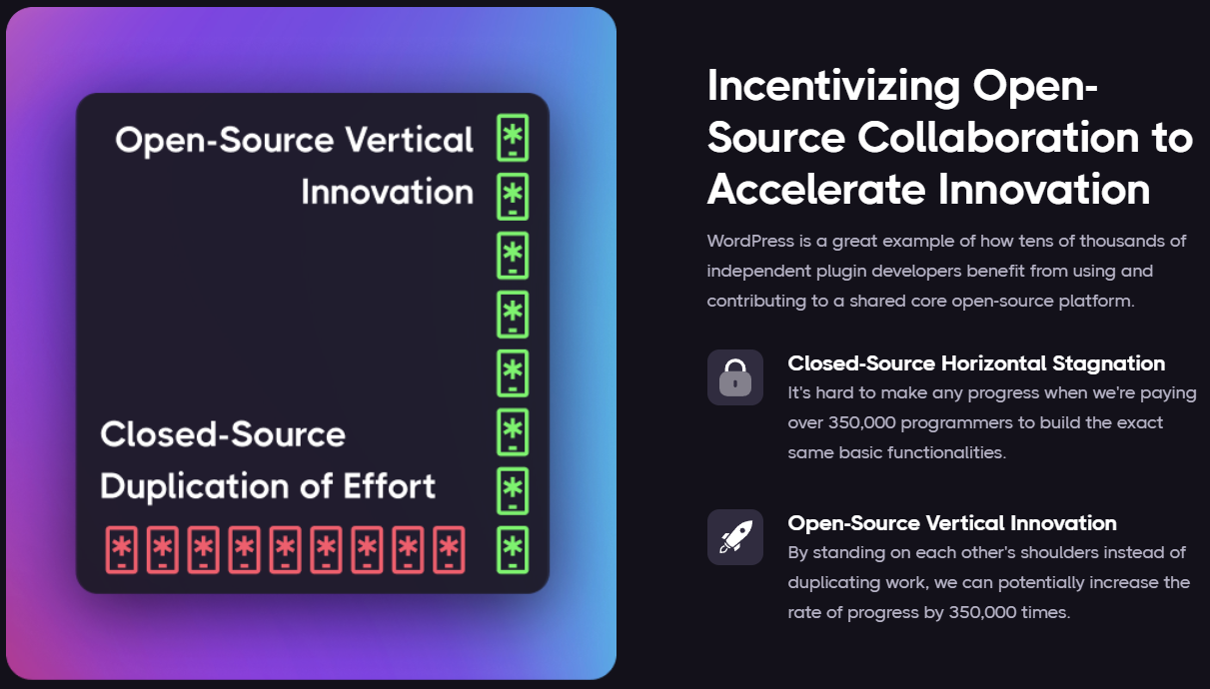
Notes:
E: Supplementary deck. You've already told us all of this. We believe you.

Slide 9

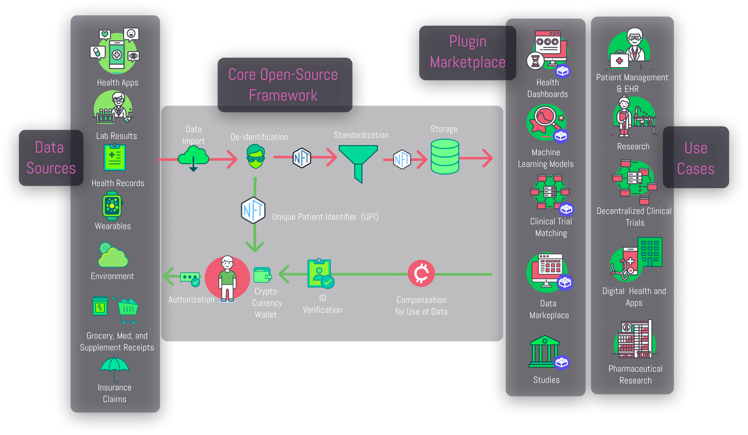
CureDAO Ecosystem
Notes:
E: supplementary deck. Super complex. Would need an hour to explain.

Slide 10
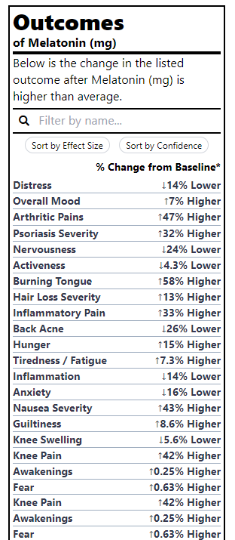
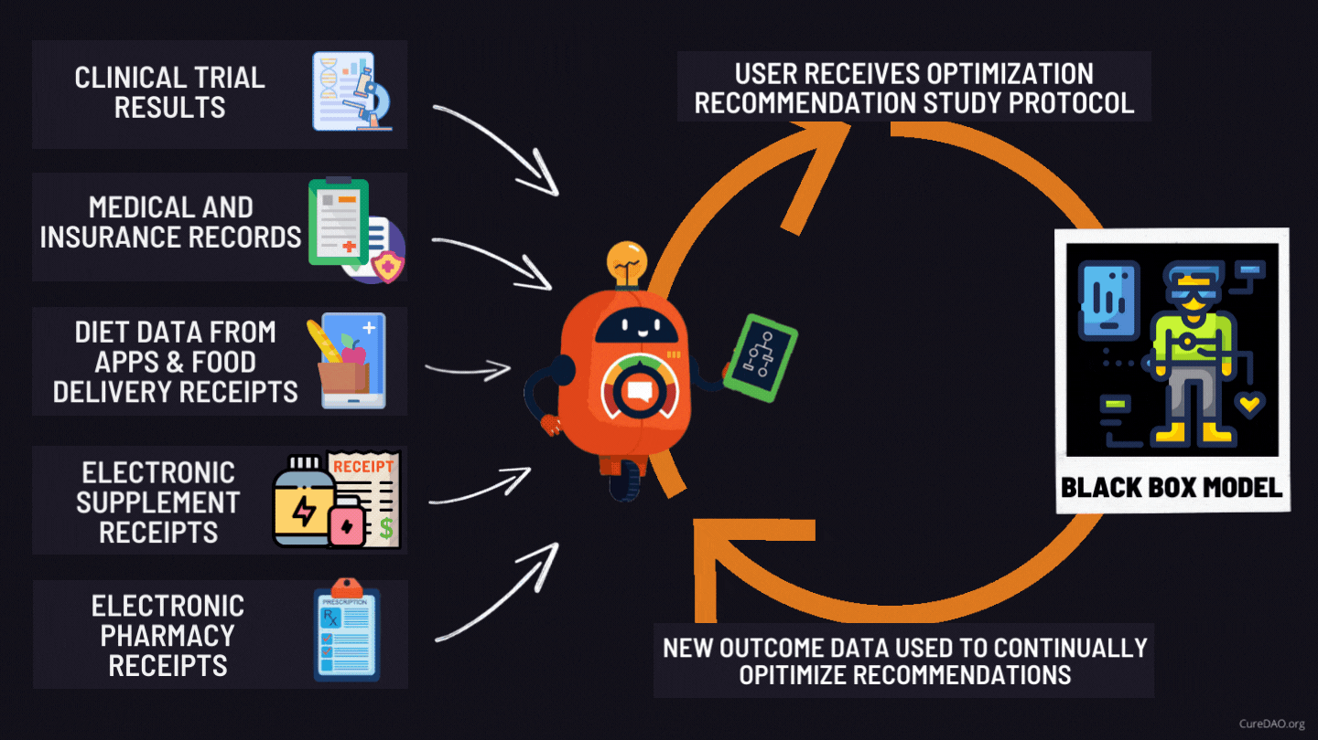
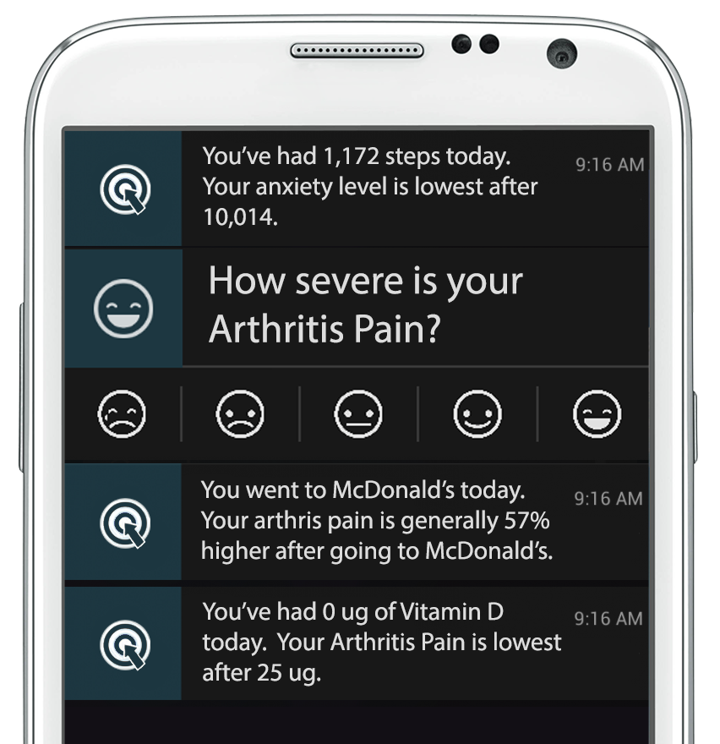
Turning Oceans of Data into Precision Health
Notes:
E: Spellcheck on "optimize"
E: This is our PRODUCT.
E: So we're creating our own "index" and weighting. For this to be accepted/funded, and for customer acquisition, we need credibility. I think cred in general is paid little to no attention in DAOs because, well, look at all this amazing traction we can get from people in the discord. See my comments in the next slide.

Slide 11
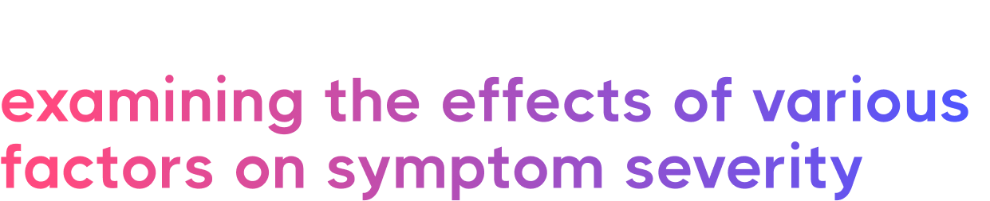

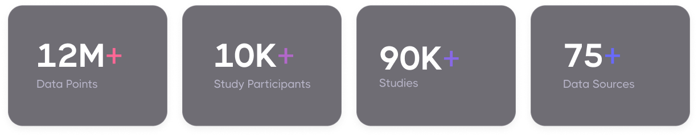
Notes:
E:
Obviously, this is an achievement of epic proportions. How did we do it? Who did it? And most importantly: why? Remember, the best stories are where the founding team scratches its own itch. Mike, your story is critical here.
E: would combine it with the previous slide, or put the previous slide in the supplementary deck
E: on building cred:
We need a whole lot of leading scientists checking this out and using it for their own studies. We need them to tout this as a great thing. We need them to have their own yearly congress on the topic.
The way we did it at OPA:
1) identify the leaders by checking out which labs publish the best papers
2) pick 3, pitch to them, and ask for intros to the rest
3) now important people are giving you cred by introducing you to others. Use this to identify the most critical problems they consider in their work.
4) now you have a whole lot of scientists getting excited. Time for an in-person meeting. Get funding. Organize a meeting, possibly with the backing of one of the NIH institutes. Pitch your product.
5) announce a source of funding, e.g., an SBIR line
6) now you are THE leading thinker in the field, you got both cred AND money for the scientists – they will support you until the money runs out

Slide 12
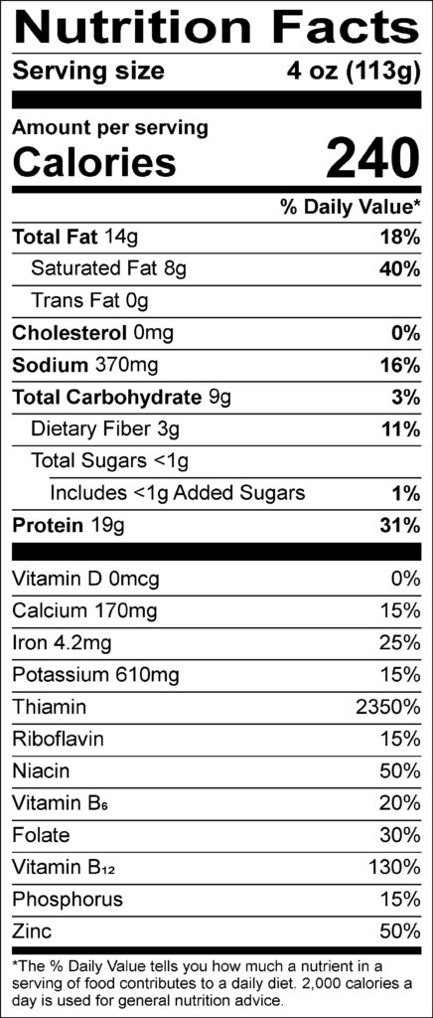
Outcome Labels
We’ve generated thousands of
to better understand the health effects of various foods and treatments.
Notes:
E: Perfect start. This is your "demo". Perhaps the copy needs a bit of work. E.g.
"Our diligent scientific approach enabled us to generate ACTIONABLE INSIGHTS to better understand the health effects of various foods and treatments"
A) emphasis on "I did not just code this for fun, but rather followed the scientific method"
B) here's how this is useful: you get something almost no QS device gave you, actionable insights

Slide 13
This lets Decision-Support Notifications provide you with the most effective initiatives to minimize your symptoms.
Notes:
E: perhaps for the supplementary deck. Make the outcome label in the previous slide into a smartphone screen so it's clear how the product is delivered.

Slide 14

Unfortunately, most individual studies on a particular treatment and outcome only have a few participants.
We need more input.
Notes:
E: let's discuss this one. Instead of what we need, I'd say what we will do. E.g., DAO membership of 10s of 000 will allow for recruitment...

Slide 15
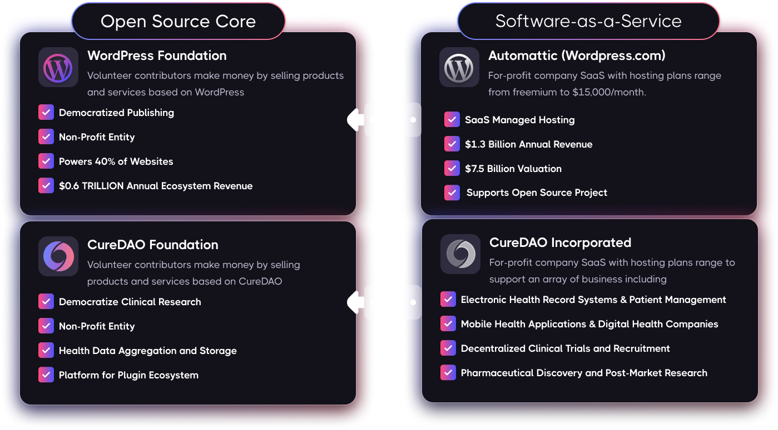
WordPress: A Model for Open-Source Success
Notes:
E: A bit of design help here. Make it all about CureDAO, then at the bottom tell us who else does it the same way. E.g. https://i.imgur.com/uODjrRU.png

Slide 16
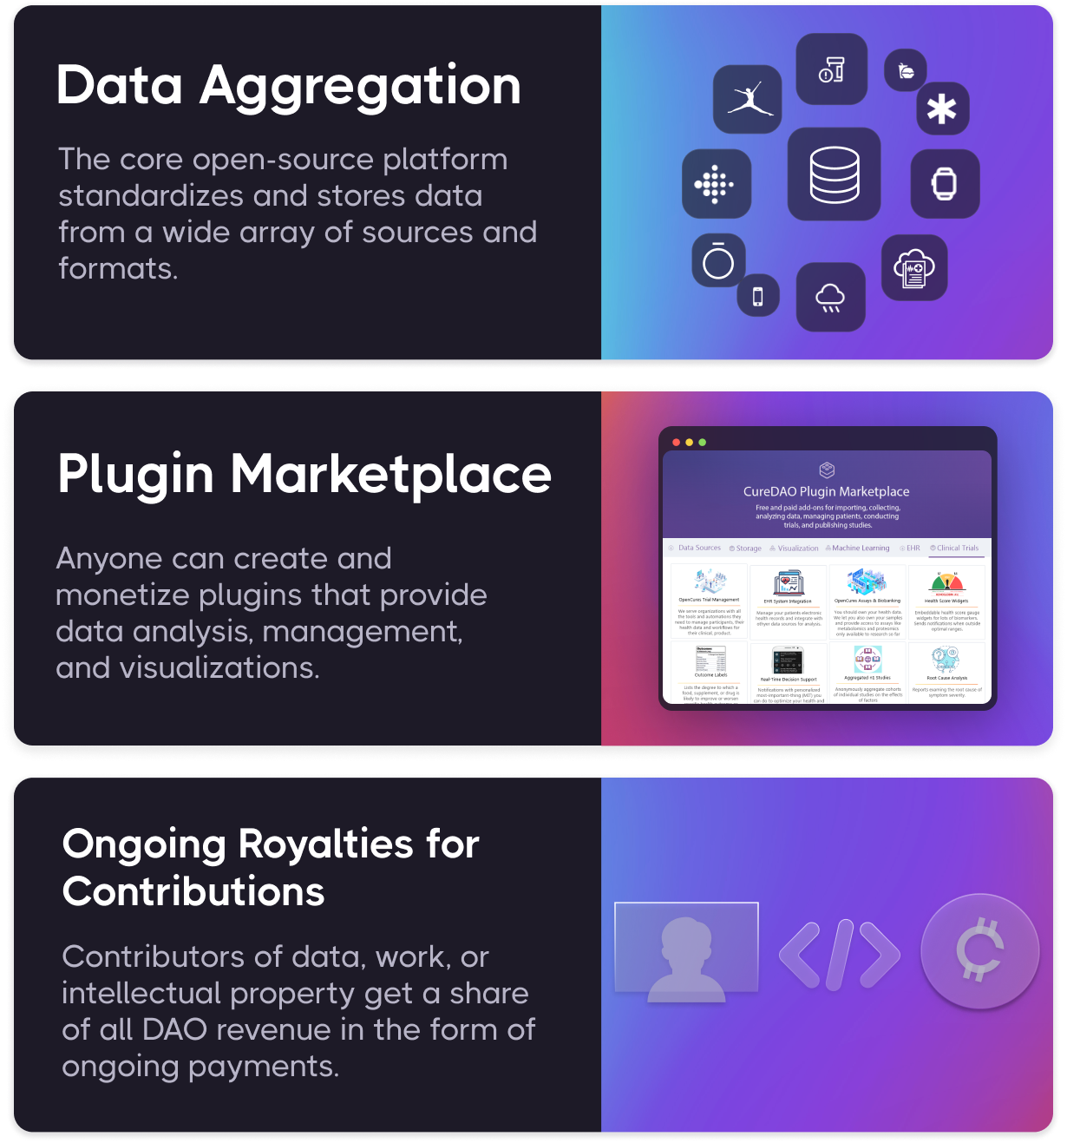
How it Works
CureDAO utilizes the power of Collaborationism and exponential technologies to drive down the time & cost of clinical research.
Notes:
E: OK, so this needs to be way earlier in the deck. And I'd rely on the fact that CureDAO is super unique in that it puts millions of members together with the same problem: they are patients. And they are struggling. And we are offering a solution. Therefore, our recruitment is a piece of cake (only sugar, eggs, chocolate, and wheat – no unknown chemicals/preservatives). Hey can you resolve my sinus allergy? I would gladly even PAY you for that.
E: We must be careful not to equate standardizing data and Joe Smith making plugins with clinical research. I would say this is how it works:
1) thousands of researchers and developers are engaged to create a core open-source platform that standardizes and stores data from a wide array of sources, in a scientifically acceptable way
2) millions of people are recruited through the DAO to volunteer their data in addition to public and private libraries; clinical trials are designed by experts and data harvested
3) the DAO launches a plugin marketplace where anyone can monetize...
4) users use the same app to input, collect data and get recommendations on a subscription basis
5) profit (I.e., ongoing royalties, we sell data to pharma, etc... )

Slide 17
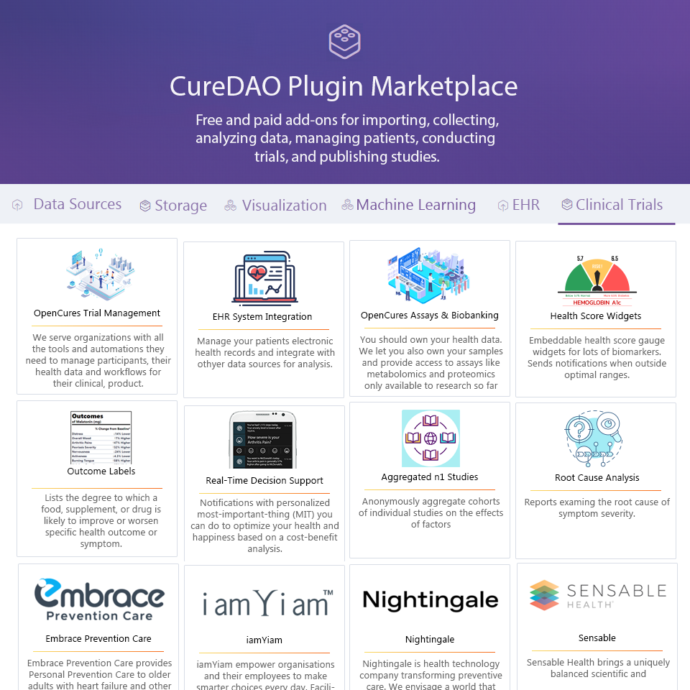
App Marketplace
Our plugin marketplace offers massive free marketing exposure through company-branded plugins. Besides that, it offers revenue derived through subscription or licensing agreements for the usage of plugins.

Slide 18
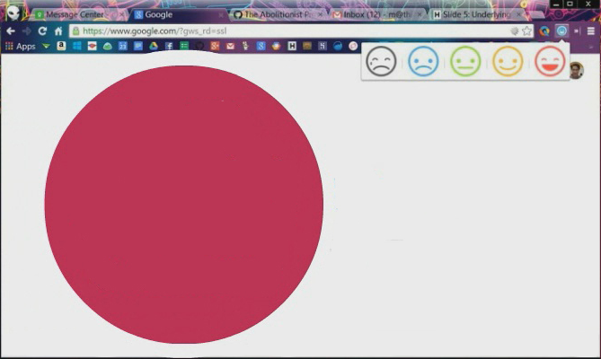

Data Collection Plugins
Back-end-
as-a-Service (BaaS) Functionality for Data Collection Apps
Notes:
E: supplementary deck.
First we developed mobile apps and browser extensions to make it incredibly easy to track your symptom severity in a fraction of a second using a unique popup interface.
Move circle
Remove browser
Screenshot of mood tracking screen

Slide 19
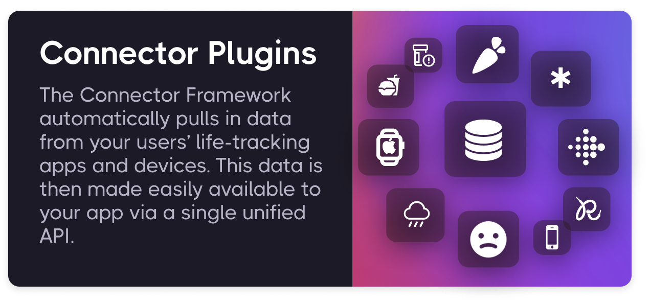
Notes:
E: supplementary deck.
Move information to the left and images to the right.
We also built the QuantiModo Connector Framework, which enabled us to automatically pull passively or actively generated user-data from dozens of applications and devices such as Fitbits, Withings scales and blood pressure monitors, and diet data from apps like MyFitness
The QuantiModo Connector Framework pulls data from dozens of applications and devices such as Fitbits, Withings scales and blood pressure monitors, and diet data from apps like MyFitnessPal.
(Only show most popular ones with names and x more)

Slide 20
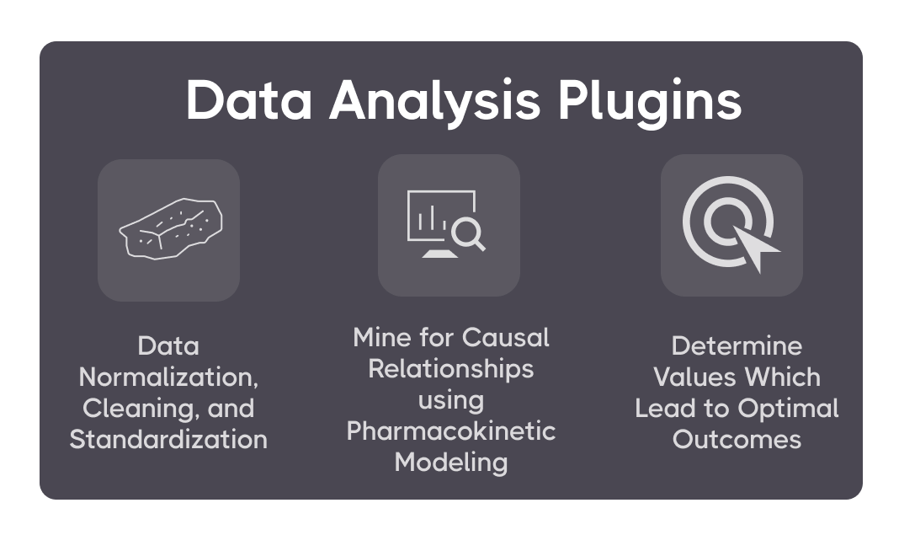
Notes:
E: supplementary deck. None of the plugin story is important. I would stick with emotional elements of our story: 1) millions of people are in pain
2) they aren't getting help
3) they would sell their own mother to solve the problem
4) we offer a solution
Change yellow background
Slow down here
Once we’ve accumulated all of this data, the QuantiModo Analytics Engine then clean the data and mines it using pharmacokinetic modeling techniques, which take into account onset delays and durations of action to determine which factors have the strongest influence on a given outcome and what the optimal daily values are.
e.g. Pizza -> might not notice effects until later that day or even gluten sensitivity until a few days later
Do you have a health tracking app? Wish you could tell your users which life factors most influence their symptoms? Now you can! The QM Analytics Engine identifies the factors that most influence any given aspect of health and their optimal ranges. QuantiModo turns this cacophony of life-tracking data into actionable insights. It does this by aggregating and mining the data using machine learning algorithms to determine what an individual can do to optimize any quantifiable aspect of human life such as mood, sleep, cognitive performance, cardiovascular health, and productivity.

Slide 21

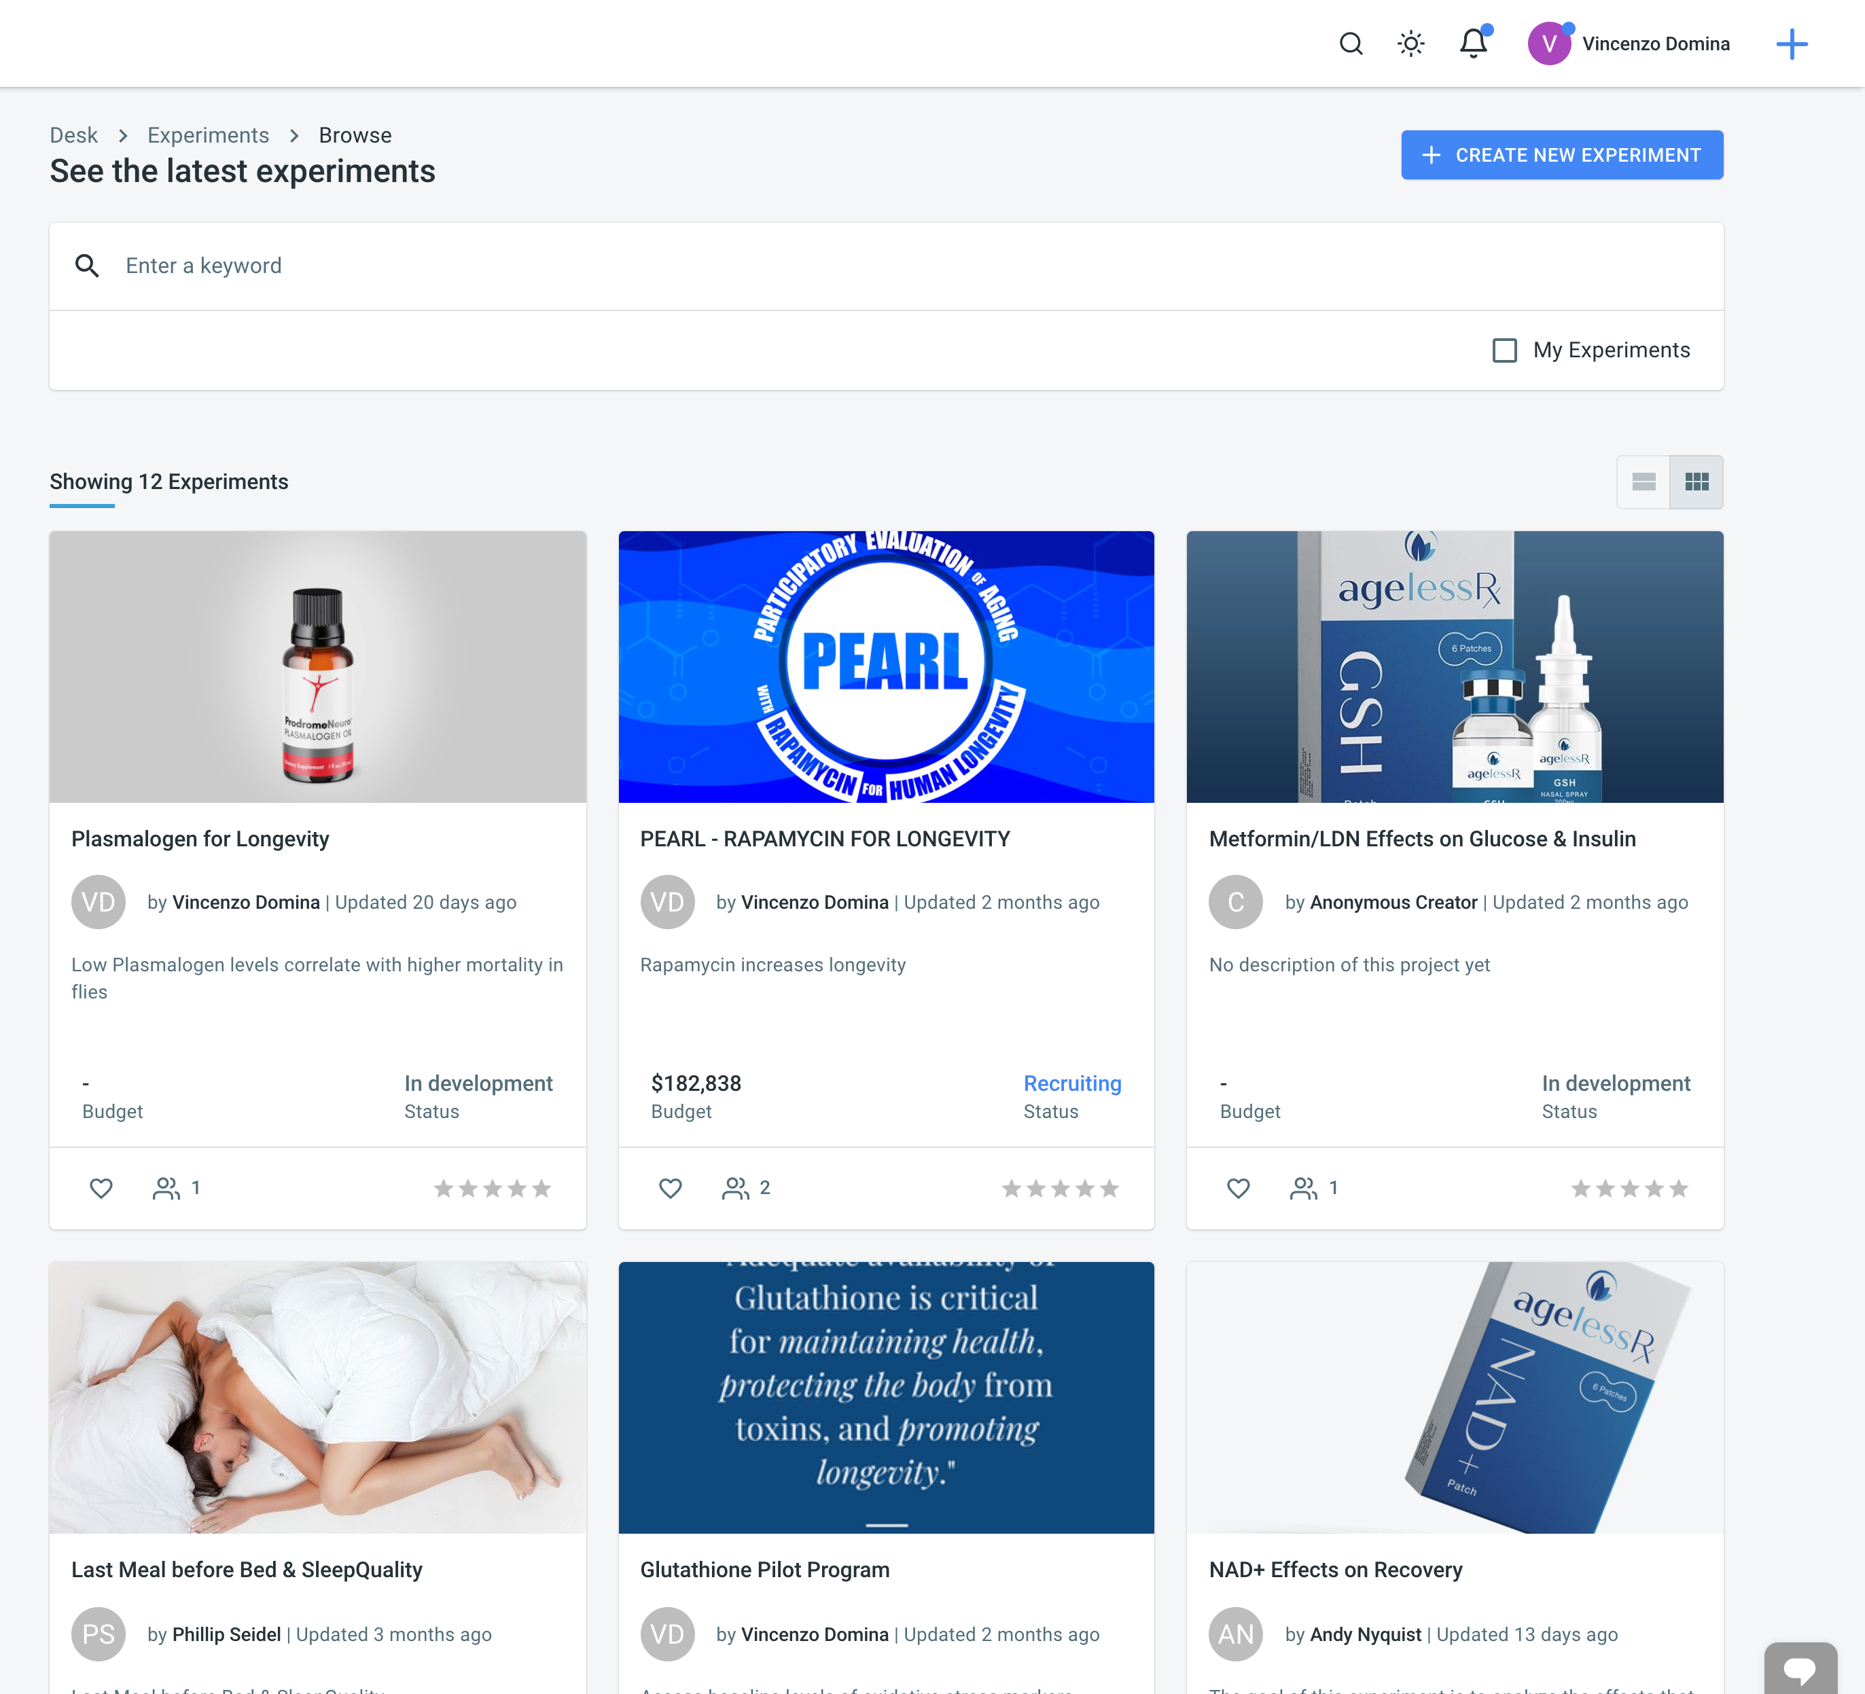
Open Cures Trial Management Plugin
CureDAO can support decentralized clinical trials, which cost less and have a higher success rate than traditional ones.
Notes:
E: supplementary deck.

Slide 22
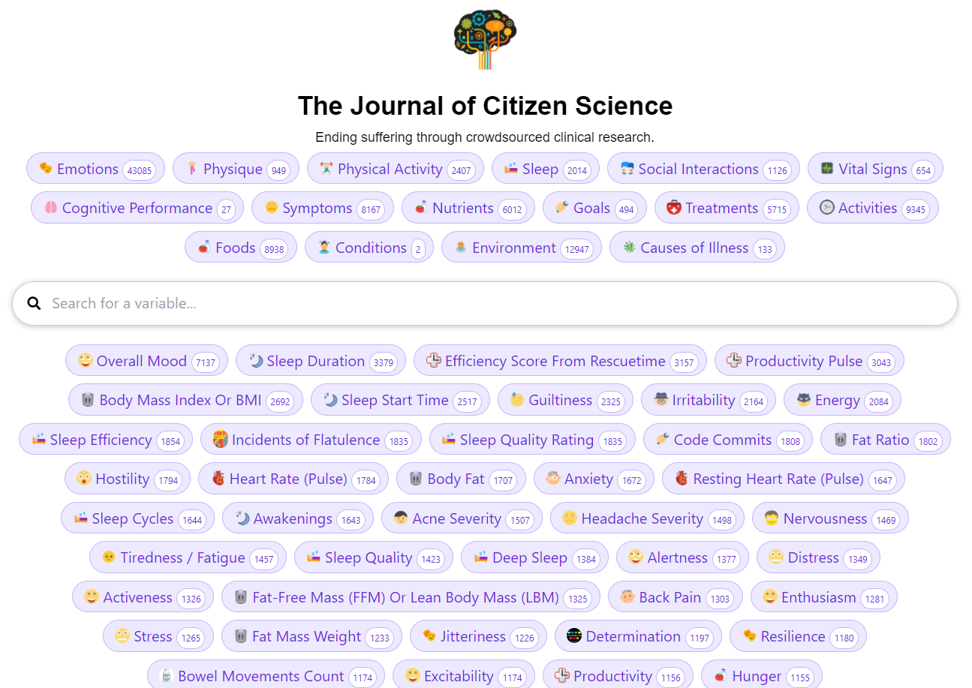
Study Generation Plugins
We’ve automatically generated 90,000 natural language studies with visualizations examining the effects of various factors on symptom severity
Notes:
E: supplementary deck. If I were an investor, I'd ask you – who's using this now? Where's your traction?

Slide 23
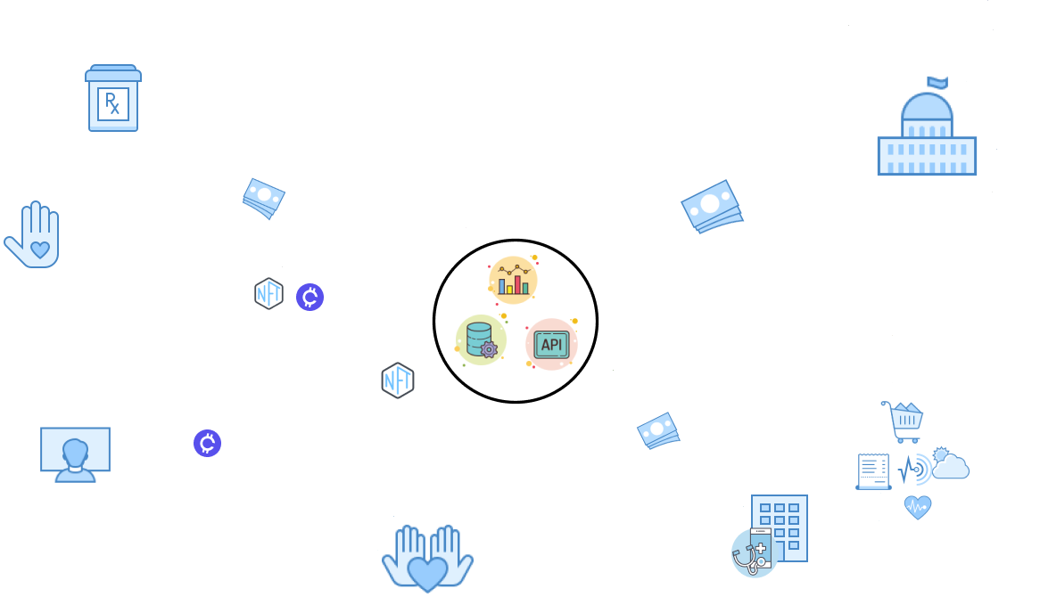
Notes:
E: supplementary deck. Instead of this, try to answer: 1) WHY NOW? (my answer: tools are here and look at our traction with the DAO)
2) WHAT'S THE COMPETITION

Slide 24
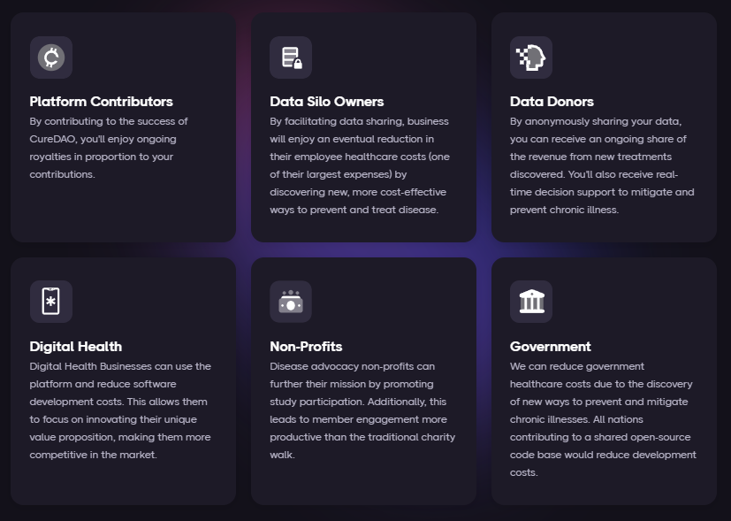
How Intelligent Voluntary Cooperation Makes Everyone Better Off
Notes:
E: supplementary deck.

Slide 25






USER SEGMENTS
Health Apps
Researchers
Patients
There are 350,000 health apps that can save months of development time and tens of thousands of dollars by using our platform instead of reinventing the wheel.
It currently costs $48k per subject in a phase 3 clinical trial. Instead of spending months gathering data, 7 million researchers can create a shareable URL that they can share with participants to authorize access to pre-existing data in quantities never seen before.
1.3 billion people managing chronic illnesses can use our client apps and browser extensions, patients can easily track their symptoms, import data from other sources, and discover hidden dietary, behavioral, and environmental factors that could be exacerbating or improving their symptoms.
Health Insurers
Pharmaceutical Companies
Healthcare Providers
Health plan providers need a more personalized approach to help their members and have found a way to do so with provider-and patient-reported digital health data. By incorporating this data into a centralized repository, payers can analyze and use this information to create and improve their various member services.
8 million healthcare providers could tremendously benefit from our dashboard visualizing all factors in a patient’s health can then help doctors formulate an informed care plan.
Treatment and symptom tracking applications would reduce the number of deaths and costs of intervention by alerting patients and their practitioners to conditions before they become irreversible. Additionally, the opportunity to meet and promote these applications to physicians would also serve as a novel new way for pharmaceutical manufacturers to connect with physicians.
Notes:
E: Interesting slide. Let's discuss. Are we saying these guys will pay us money? Use our final product? We should use this slide, just need to understand.
Who Will Pay, 6 segments
Developers
There are 97,000 health apps which can save months of development time and tens of thousands of dollars by using our platform instead of reinventing the wheel.
Researchers
It currently costs $48k per subject in a phase 3 clinical trial. Instead of spending months gathering data, 7 million researchers can create a shareable url that researchers can share with participants to authorize access to pre-existing data in quantities never seen before.
Patients
1.3 billion people managing chronic illnesses can user our client apps and browser extensions, patients can easily track their symptoms, import data from other sources, and discover hidden dietary, behavioral, and environmental factors that could be exacerbating or improving their symptoms.
Health Insurers
Furthermore, this new digital health solution would help to drive down cost for insurance providers. Health plan providers need a more personalized approach to help their members and have found a way to do so with provider-and patient-reported digital health data. By incorporating this data into a centralized repository, payers can analyze and use this information to create and improve their various member services. For example, in addition to supporting patient-specific care-management models, integrated data could enable the creation of wellness programs, preventive or disease-management care initiatives or even health-coaching programs. This personalized data can go beyond incentivizing and motivating healthy lifestyles; it can also help payers increase member engagement, a critical objective for many health plan providers.
Pharmaceutical Companies
106,000 people die annually in the U.S. from properly prescribed drugs. The number of people having in-hospital, adverse reactions to prescribed drugs to be 2.2 million per year. The total number of deaths caused by conventional medicine is 783,936 per year. Pharmaceutical companies spend over $2 billion a year on over 314,000 events attended by doctors.
Initial sponsor applications will be focused on tracking adverse reactions to the medications known to produce the most adverse reactions. MEDTLC, QuantiModo’s treatment and symptom tracking application would reduce the number of deaths and costs of intervention by alerting patients and their practitioners to conditions before they become irreversible. Additionally, the opportunity to meet and promote these applications to physicians would also serve as a novel new way for pharmaceutical manufacturers to connect with physicians.
Healthcare Providers
A dashboard visualizing all factors in a patient’s health can then help doctors formulate an informed care plan.

Slide 26
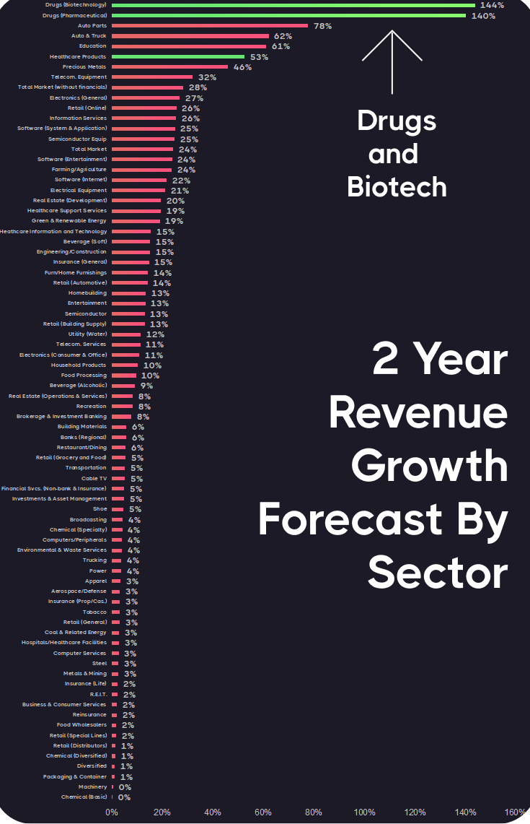
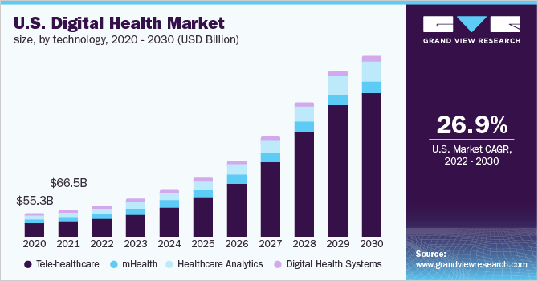
Market Trends
https://www.healthcapital.com/hcc/newsletter/02_21/HTML/2040/convert_healthcare_in_2040.php#_ednref4
Notes:
GDP data according to the 2021 Deloitte report - https://www.healthcapital.com/hcc/newsletter/02_21/HTML/2040/convert_healthcare_in_2040.php#_ednref4
Digital health has a 50% compound annual growth rate
Health analytics is a $30 billion dollar industry poised for exponential growth, driven by exponential data and innovation growth.
TAM or Total Available Market is the total market demand for a product or service.
SAM or Serviceable Available Market is the segment of the TAM targeted by your products and services which is within your geographical reach.
SOM or Serviceable Obtainable Market is the portion of SAM that you can capture.
E: Market slide, great. See what the SAM and TAM would be here? https://www.thebusinessplanshop.com/blog/en/entry/tam_sam_som

Slide 27



B2B DATA AGGREGATION AND ANALYSIS SaaS REVENUE STREAMS
Customers
268,747 application developers, researchers, and healthcare providers
Subscription Pricing
$600 per month per 5000 end-users
On-Site Licensing
Fair Code model which requires licensing for for-profit usage
Notes:
E: nobody asks you about pricing this early and it would unusual to expect to have a pricing strategy. Leave that out.
E: where does the 268k number come from? E: combine with Market slide

Slide 28
Benefits of A DAO
Government Action Against a DAO Would Be A Logical Fallacy
Incentivizing Data Silos Facilitating Data Sharing
Trust by Personal Data Sharers
A Class Action Lawsuit Against the DAO Would Be Masochistic
Since every data silos would be rewarded with governance tokens, a DAO provides a way for the 350k apps to all share in the upside of the increased value of the data, turning a zero-sum game into a positive-sum game.
Everyone that shares their data receives governance tokens. The fact that they are owners of a transparent organization would make them more comfortable than sharing with an opaque corporate entity.
If the users govern the DAO, they’d be less unlikely to act against themselves. If they did file a class action suit against the DAO, they would be suing themselves, driving down the value of the token by the total payout in addition to the legal fees.
Any government fines imposed on the DAO would be harming the data owners that they are supposed to be protecting. If the government doesn’t allow people to govern their own data, then it would be acting completely undemocratically.
Notes:
E: supplementary slides
Cons
DAOs are slow and inefficient.
Duplication of effort by multiple doing the same thing (typically the most enjoyable tasks), since everyone can do whatever they want instead of being managed by a central authority
Everyone thinks they're an expert, and non-experts can have the same or more influence than actual experts.
Reduced competition (however, you'd still have competition between plugin/extension creators)
Pros of a DAO
Trust by Personal Data Sharers – Everyone that shares their data receives governance tokens. The fact that they are owners of a transparent organization that has their data seems like it would make them more comfortable than sharing it with an opaque corporate entity.
Trust and Mutual Benefit by 350k Data Silos Facilitating Data Sharing – Currently, there is little to no net incentive for a health app to facilitate easy data sharing (unless it's a device manufacturer that gets free advertising like Fitbit). Isolated data streams can only provide relatively useless "descriptive" statistics that tell you what you've done, rather than "prescriptive" statistics that tell you what you should do. So in aggregate, the value of the data increases dramatically. A DAO provides a way for the 350k apps to all share in the upside of the increased value of the data, turning a zero-sum game into a positive-sum game.
Decreased Wasted Duplication of Effort and Increased Interoperability – $157B has been spent developing all these apps. Much of it has reinvented the wheel regarding basic health data infrastructure. The result is thousands of disparate non-interoperable data formats. Suppose there was a shared core open-source framework for storage, aggregation, and access with DBT data transformer plugins enabling ingestion and access in any desired format. In that case, this could accelerate progress by freeing up these resources for innovations. Many companies are trying to make their own "Digital Health Platform." However, whichever one you use for your app will be stealing some of the value. By having a collectively owned platform, everyone shares the benefits of its success.
A Class Action Lawsuit Against the DAO Would Be Masochistic – Everyone who donated their data to the DAO would also govern the DAO. So by definition, the DAO would never act against the wishes of the users. If, for some reason, they did file a class action suit against the DAO, they would just be suing themselves. This would drive down the value of the token by the total payout in addition to the legal fees.
Government Action Against a DAO Would Be A Logical Fallacy – The purpose of government regulation of health data is to protect individuals from violations of privacy by third parties. Any government fines imposed on the DAO would be harming the data owners that they are supposed to be protecting. Additionally, if the data owners govern the actions of the DAO, and the government decides that they aren't correctly governing their own data, then the government would be acting completely undemocratically. They would also be making the case that the people don't really own their data, the government does.

Slide 29
Growth strategy
How we’ll scale in the future
DAO MEMBER GROWTH
CUSTOMER GROWTH
Developer Growth
Reward study participants with tokens to give them ownership of the platform and compensation for data contribution
Give tokens to strategic partners with significant influence to incentivize them to use their platforms to grow the DAO
Create Plugin Framework
Incentivize sharing studies on social media with personal referral URLs that are tied to smart contracts which reward individuals based on their contributed value
Establish partnerships with as many of the 350k digital health apps as possible by:
Creating great developer documentation and easy integration
Facilitate lots of additional functionality through the plugin framework
Including a “Powered by CureDAO” that can be removed through upgrading to a white-labeled version

Slide 30
COMPETITORS
Collaborators
Our mission is to compete with no one and integrate with everyone. However, some similar closed, private potential collaborators are listed below.
Company | Number of Employees | Total Raised | Valuation | Per user/month
Human API | 91 | $36,600,000 | $494,594,595.00 | $0.36
Validic | 76 | $18,400,000 | $248,648,649.00 | $0.24
Medable Axon | 381 | $518,000,000 | $7,000,000,000.00 | $0.50
Patients Like Me | 60 | $151,000,000 | $2,040,540,541.00
Science37 | 509 | $106,500,000.00 | $1,439,189,189
Florence Healthcare | 155 | $88,800,000.00 | $1,200,000,000
datavant | 133 | $81,500,000 | $1,101,351,351
Notes:
E: you cannot compete with no-one. Remember that you are sending the message that you are better and smarter than these companies because you will not fail and will make more money. Let's discuss.
Valuable collaborators include:
Closed-source decentralized clinical trial companies like Medable
Health data aggregators like Validic
However, our mission is to compete with no one and integrate with everyone.

Slide 31
PRIMARY MARKET (SaaS)
268,747 Potential Customers
97,000 Health and Fitness Applications
165 Pharmaceutical Companies
171,582 Hospitals
Notes:
E: supplementary slides
*provide them with a platform for recruiting new users, storing their data, and analyzing it. So they can do what currently takes months in a matter of hours.

Slide 32
Product Roadmap
DONE
Q2
Q3
Q4
TODO
TODO
TODO
API Platform
Data Collection & Analysis Plugins
Data Importers from Dozens of Sources
Software Development Kits in 8 Languages
Data Collection Apps
Study Generation and Causal Inference
Clinical Trial Management
HIPAA Compliant Storage
No Code App Builder
8 Partnerships
60 DAO Members
Establish a legal entity
Apply for SBIR, other grants, & fundraising
Mint $CURED tokens that are available via a fair and public auction
Automate token compensation
Bounties for security issues and bugs
Better Documentation of the SDKs and API
Developer Support for the Various Languages
Create Plugin Framework
GUI Data Mapper to Add New Data Import and Export Formats
Example integrations/projects in all languages
Billing mechanism to charge tokens for usage
Support OpenCures and AgelessRX in a Clinical Trial for Rapamycin
Partnerships with as many of the 350k digital health apps as possible
Reference Data Search and Wiki for the curation of variable data links/documentation
Additional data importers
Federated learning, homomorphic encryption, or decentralized data storage
Support Lifespan.io in a Clinical Trial for Alzheimers’s
Notes:
E: Cool. Put it before the financials

Slide 33

Growth Roadmap
start
build
scale
M
M
M
Traction / Value
Partnerships from the 350k digital health apps market
Reference Data Search and Wiki for the curation of variable data links/documentation
Expand data importers
Launch federated learning, homomorphic encryption, decentralized data storage
M
Plugin Framework
GUI Data Mapper
Example integrations/projects in all languages
Token billing mechanism
Established DAO
Establish API Platform
Establish Partnerships
Legal entity
Tokenomics and minting
Time

Slide 34


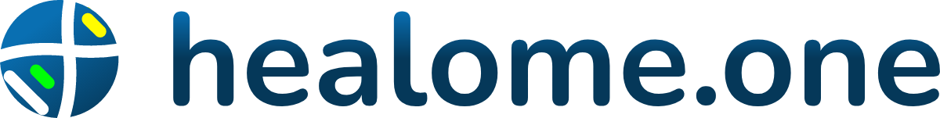
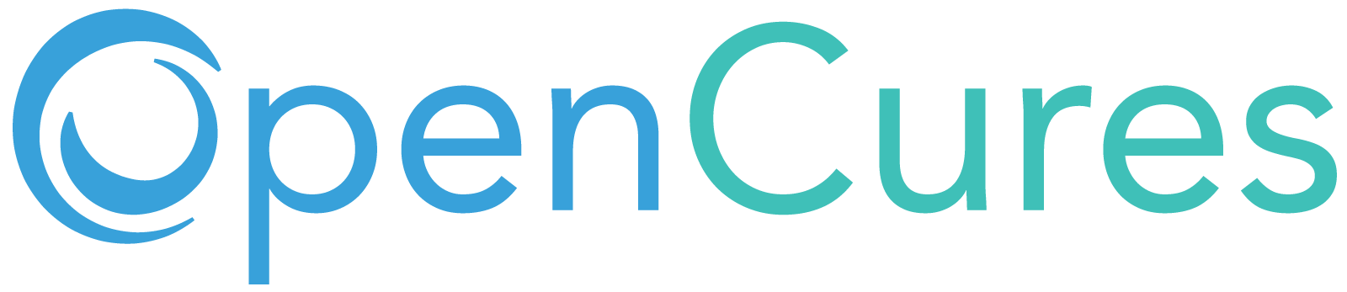

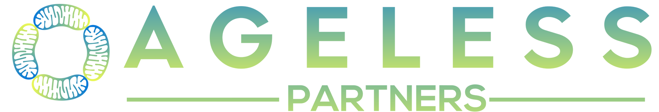




Current Partners
Notes:
E: Aha! The traction slide! It would be pretty cool to add 50 universities here.

Slide 35
Use of Funds
Support for Two Decentralized Clinical Trials
Lifespan.io is conducting a clinical trial on a novel new therapy for preventing and treating Alzheimer’s disease
OpenCures is conducting a trial to quantify the effects of Rapamycin on aging and longevity.
Notes:
E: Nah. We are raising the money to spend on salaries and R&D. Let's discuss because it needs a lot of time to put together.

Slide 36
PEARL
PARTICIPATORY EVALUATION OF AGING WITH RAPAMYCIN FOR LONGEVITY
The following tests will be conducted for evaluating efficacy:
1. Autonomic health tests – including baseline (am) heart rate and baseline (am) heart rate variability testing.
2. Blood tests – Standard measures of risk of age-associated diseases (glucoregulatory markers, lipids), and markers of inflammation.
3. Body composition testing with DXA scans – measuring bone density as well as visceral fat content.
4. Fecal Microbiome testing.
5. Immune Health Tests – including CD4/CD8 ratio, CMV IgG, TNFɑ, hsCRP, and IL-6.
6. Methylation age–clock testing (e.g. Horvath clock, GrimAge).
7. Skeletal muscle tests – including lean body mass on DXA scan.
8. Physiological data – wearable devices (steps, HRV, etc).
https://www.lifespan.io/campaigns/pearl-participatory-evaluation-of-aging-with-rapamycin-for-longevity

Slide 37
Stopping Alzheimer's with Light and Sound
The Assessment group would focus on software for the cognitive test. This will require assessing scientific literature and either using and adopting available cognitive tests, such as MiniCog, and/or developing news test that would function on either an iOS/Android smartphone, tablet and/or computer workstation. Another key goal of the assessments group is to have protocols in place that would mimic a trial study with controls and experimental groups that would be the best fit for this type of self-administered device. Development of the “trial protocol” itself may involve considerable overlap with members' expertise among all three working groups.
The Analytics group will need to determine the best way to securely store and manage the data arriving from the self-assessment test (IRENA) and determine the best analytical tools to apply to tease out positive outcomes. This will help determine not only which multi-intervention combinations are effective, but also enable us to determine the minimal numbers of participants required to revisit any promising intervention for any future follow-up studies in a more traditional “gold standard” double-blinded clinical trial. If this approach works, it would have the profound effect of upending how standard clinical trials are designed in the future.
https://gitcoin.co/grants/3853/stopping-alzheimers-with-light-and-sound

Slide 38
Annual Expenses
Position | Total Annual Cost w/ Benefits | Hours per Week | Description
Java Developer Support | $93,750 | 40 | Developer support, documentation, demo projects
JavaScript Developer Support | $96,250 | 40 | Developer support, documentation, demo projects
Python Developer Support | $93,750 | 40 | Developer support, documentation, demo projects
Systems Administrator / DevOps | $91,250 | 40 | Maintains core API infrastructure and deployment and monitoring
Design Lab Director | $75,000 | 40 | UI/UX and General Graphic Designer / Designs market materials, admin panel features
PHP Developer Support | $93,750 | 40 | Developer support, documenation, demo projects
Data Scientist | $137,500 | 40 | Internal DAO optimization and marketing analytics,
Android Developer | $93,750 | 40 | Developer support, documenation, demo projects
iOS Developer | $93,750 | 40 | Developer support, documenation, demo projects
Tokenomics Lab Director | $210,600 | 40 | Solidity Smart Contract Developer
Administrative Assistant | $52,000 | 40 | Everything else
Dev Lab Director | $119,600 | 40 | Dev team lead - Product Owner / Scrum Master/ Project Manager, Coordinates, recruits and manages developers
HR Lab Director/Community Manager | $89,286 | 40 | Recruits DAO members, manages compensation and benefits, performance evaluation, general onboarding
Legal Advisor | $137,800 | 8 | Health and IP Law
Gov Lab Coordinator | $28,080 | 12 | Creates and publishes proposals
Collab Lab Director | $119,600 | 40 | Recruits, negotiates with, promotes collaborating organizations like health apps, other DAOs, health organizations, government agencies
Org Lab Coordinator (CEO) | $119,600 | 40 | Coordinates between all labs
Comms Lab Director (CMO) | $119,600 | 40 | Recruits DAO members by creating awareness and establishing a positive public image
Money Lab Director (CFO) | $119,600 | 40 | Pitches venture capital firms, manages crowdfunding campaigns, handles sales, accounts payable/receivable
TOTAL ANNUAL HR BUDGET $1,984,516

Slide 39
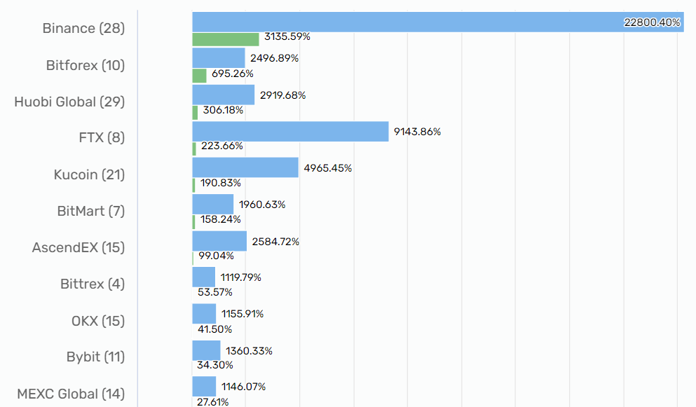
Our Goal is an IEO on Binance Launchpad
By achieving their average return of 3136% we can maximize the incentive to study participants, partner integrations, and plugin developers to contribute to the project.
https://cryptorank.io/ieo-platforms-roi

Slide 40
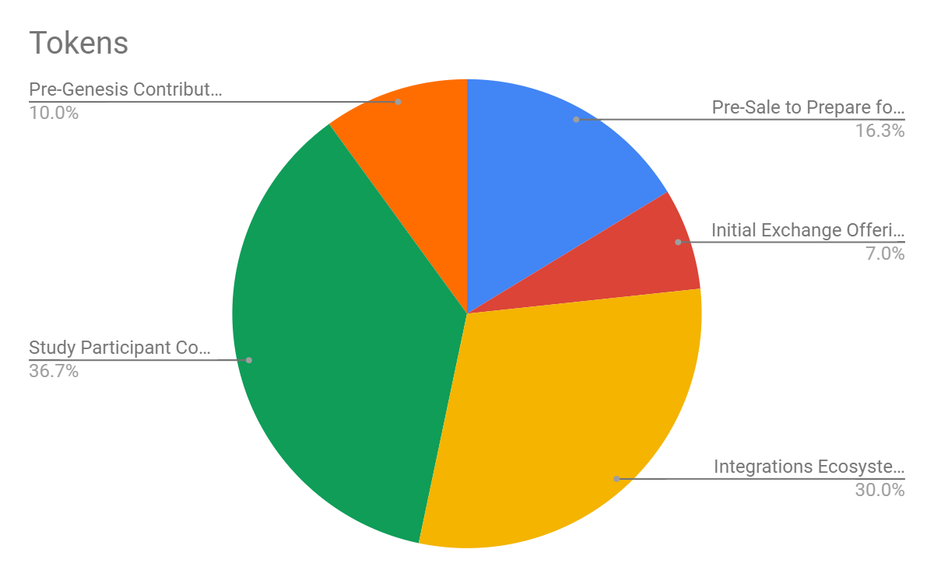
Tokenomics are a Combination of Optimal
Stage | Tokens | Price | Value | Valuation | % Supply | Description
Pre-Sale to Prepare for IEO | 978,000,000 | $0.005 | $4,890,000 | $30,000,000 | 16.30% | Fund developer support in an array of languages and integrate with as many data silo partners as possible
Initial Exchange Offering (IEO) | 420,000,000 | $0.01 | $4,200,000 | $60,000,000 | 7.00% | Initial Exchange Offering (IEO)
Data Silo Integrations Ecosystem | 1,800,000,000 |  |  |  | 30.00% | Integrations Ecosystem
Study Participant Compensation | 2,202,000,000 |  |  |  | 36.70% | Study Participant Compensation
Pre-Genesis Contributors & Advisors | 600,000,000 |  |  |  | 10.00% | Pre-Genesis Contributors & Advisors
Total | 6,000,000,000 |  | $9,090,000 |  | 100.00% | Total

Slide 41
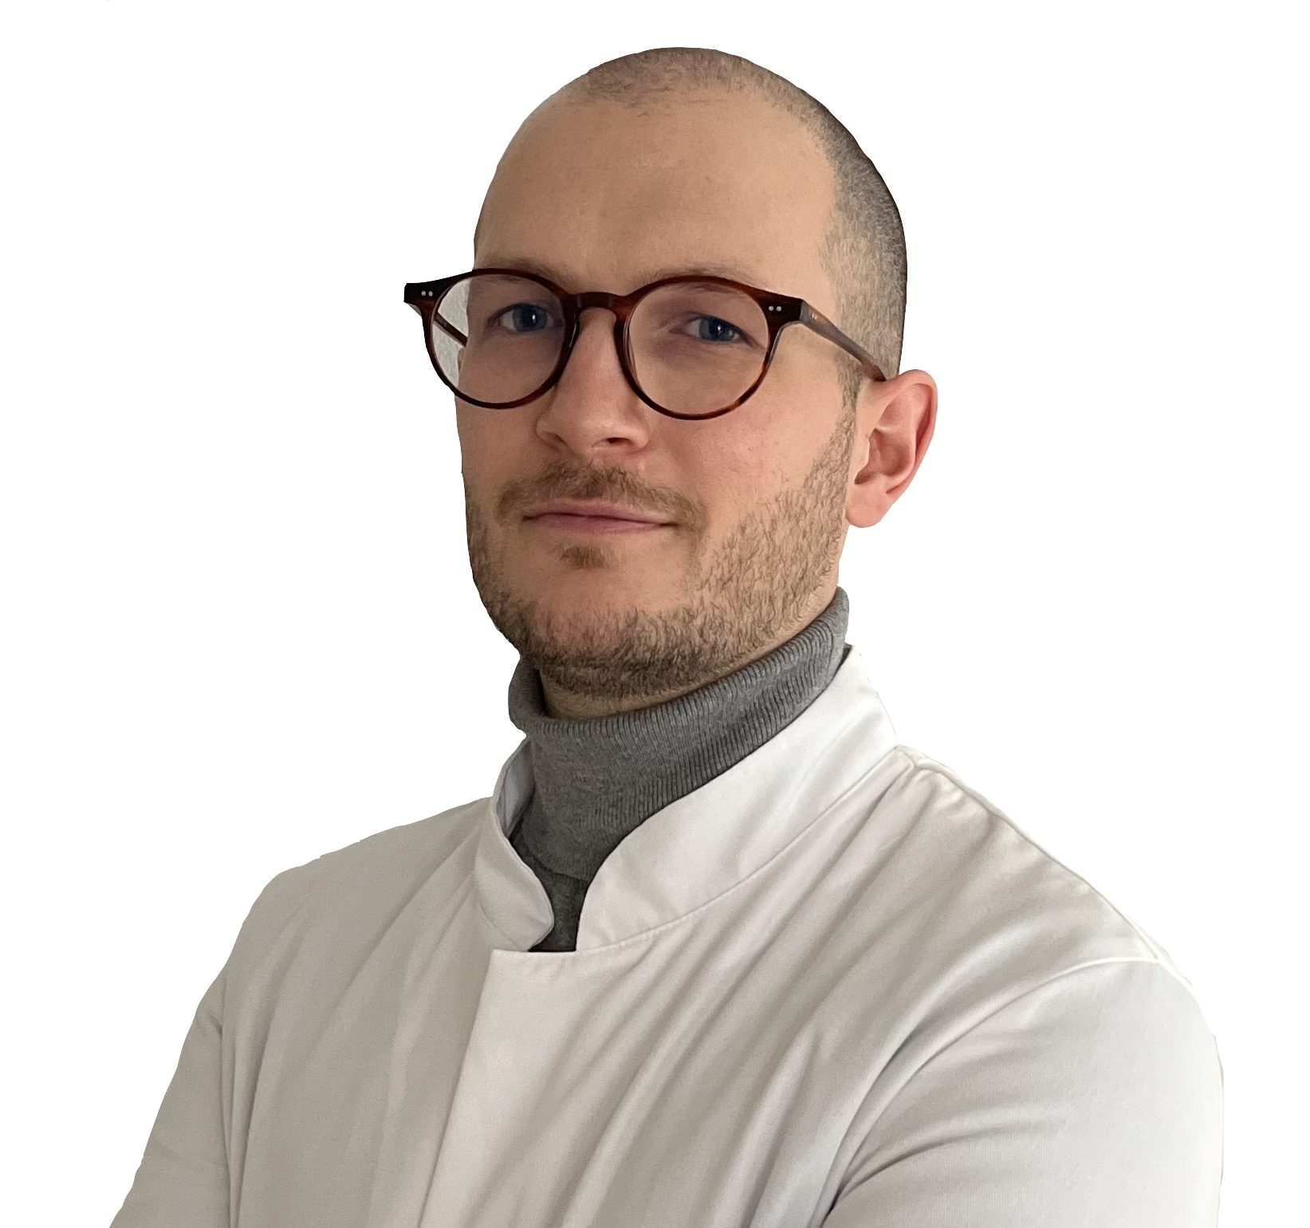
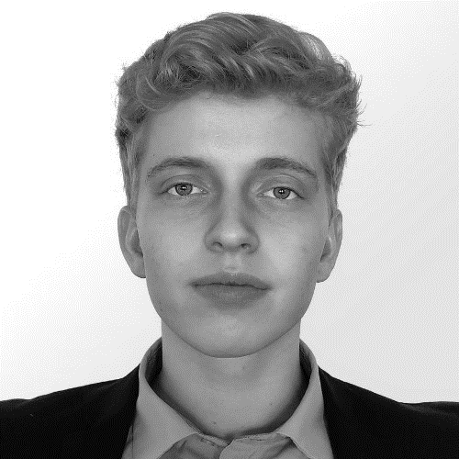
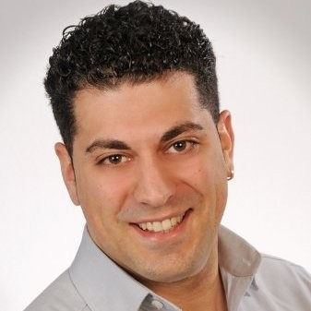
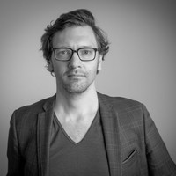

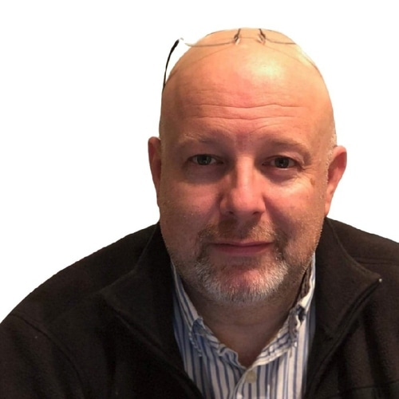


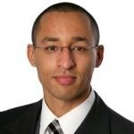
Contributors
DR. Lukas Vogel
Andreas Melhede
Vincenzo domina
Mark Melnykowycz
Mike P. Sinn
BSc Electrical Engineering and Physics, Decade of Root Cause Failure Analysis, Engineering Management, and Software Engineering Experience
MD with a passion for Blockchain and Science
Community Lead at FutrDAO & Core Team at CureDAO
Masters of Automotive Engineering | Frontend Developer & Co-Founder at OpenCures
Product Development @IDUN Technologies - Artist/Engineer
Todd white
Jason c. mercurio
Noah Weber
Eli Mohamad
Operations Steward at VitaDAO, Managing Director of the Vitality Healthspan Foundation, and ODLB Fellow
Quantitative Analyst & Founder & CEO at Ageless Partners
CTO at CelerisTx, tackling incurable disease with AI. University lecturer on AI/software-related topics. Kaggle grandmaster.
Chairman of the Board at Narwhal Sciences - Launched a $300M program for organ preservation with the White House and DoD
Notes:
Would love to put in the photo of you from the VitaDAO event if possible, Mike?
E: combine board and team in one slide, see many examples

Slide 42
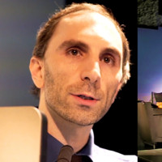
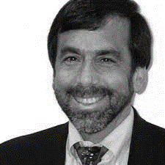
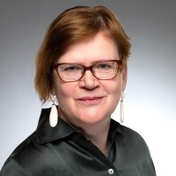

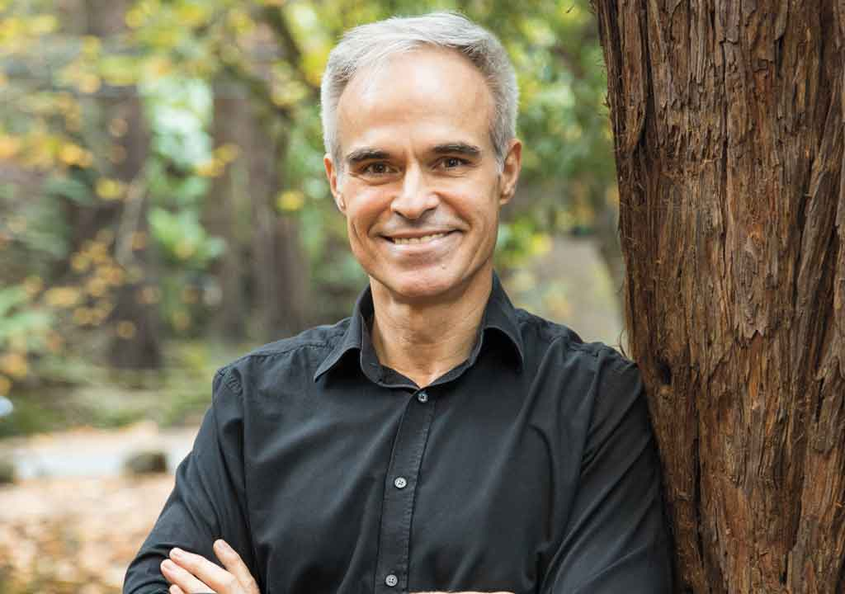
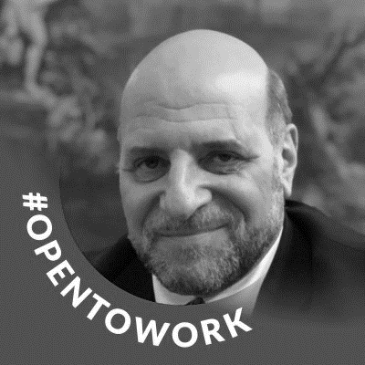
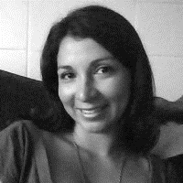
Advisory board
Keith COMITO
DR Michael LIEBMAN
President at Lifespan Extension Advocacy Foundation | Lead Software Engineer - Tech Lead, Advanced Research at Disney Streaming Services
DR Helena Slama
Piotr Motykiewicz
32 years of experience in medicine and biomedical research. Managing director of IPQ Analytics and Strategic Medicine
MD | EMBA | Master of Translational Medicine and Biomedical Entrepreneurship
10 years running a 2M user social network as head of engineering and product
DR. KEVIN PERROT
Paul Spiegel
DR Juanita Mathews
Co-Founder of SENS Research Foundation, CEO at OpenCures, & Co-founder & Adjunct Professor – University of Alberta
J.D. UC Berkeley/Harvard School of Law | Associate Editor, California Law Review | Harvard Law School Dean's List | Specializes in IP law and international business
Staff scientist at Tufts University with Dr. Michael Levin at the Allen Discovery Center

Slide 44
Appendix

Slide 45
BUSINESS VALIDATION
80% of Clinical Trials Fail Due To Inadequate Recruitment
Successful ones often spend upwards of $30M on Recruitment
Validic has received over $12 million in investments this year
Human API has received $6 million in new investments this year
Continued >50% CAGR projected in the digital health space

Slide 46

Current Total Addressable Market
613 Million People Track a Health Indicator
x $3 /user/year
= $1.8 Billion TAM
Notes:
We have 6 different segments with 6 different pricing models…
The digital health space has been growing with a massive 50% compound annual growth rate. The healthcare analytics market is a $30 billion dollar industry and includes remote patient monitoring, telehealth, and behavior modification technologies.
Given that Validic and the Human API are already charging about $4 or $5 per year per user. So, we believe that $3 per year per user is a competitive price point for us.
613 million people are tracking a health indicator.
$3 per individual per year produces a $1.8 billion-dollar total addressable market for CureDAO.

Slide 47
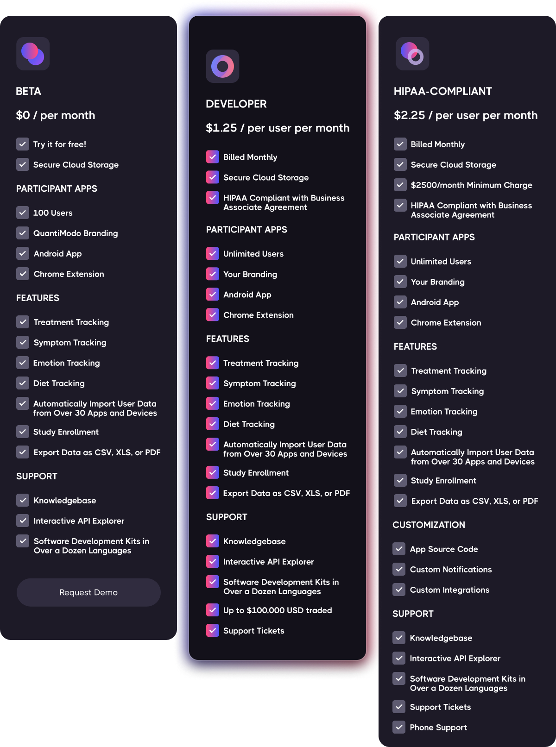
SaaS
Pricing

Slide 48

Initial Legal Structure
Located in the British Virgin Islands
Future Structures
1. Syndicate Investment Club – Unaccredited US Investors
2. Swiss UNA – Larger International Investors
https://www.figma.com/file/qvlQsfIxJlWZW4nxupXgwk/organizational-structure-and-cash-flow?node-id=31%3A683
Notes:
E: supplementary slides

Slide 49

https://www.figma.com/file/pS3zfchd1JmV10GgFDsmck/curadao-platform-diagrams?node-id=348%3A3460

Slide 50

Overcoming Challenges with Real-World Evidence and Inferring Causal Relationships
Predictive control model machine learning algorithms can systematically determine optimal treatment dosages based on measurements obtained under real-life conditions involving noise, disturbances, and uncertainty.

Slide 51

Decentralized Exchange IDOs
Current and ATH Average Returns since IDO (ROI) by Platforms
https://cryptorank.io/ieo-platforms-roi

Slide 52
Links
Presentation Notes
Whitepaper
Population Study Example
Benefits of Decentralized Clinical Trials

Slide 54

Notes:
We're creating an open-source platform to determine the effects of every drug, food, and supplement on human health.
E: The tagline's role is to make what we do understandable. The tagline above is much clearer than what's on the slide.
E: Let's stick to super simple explanations throughout the deck – if you need to, you can always explain (or complicate) further in your narrative while delivering the pitch. The guiding rule should be: do you immediately have questions, without trying, after reading a sentence, the answers to which would likely explain critical aspects of the concept? If so, simplify. Example: "A collaborative framework for the precision health of the future"
My immediate questions: Collaborative how? What framework? What do they mean by precision health? Does it involve doctors? Changing the system? Why "future"? Will it need many years for my ROI?
Vs:
"The open source platform to determine the effects of every drug, food, and supplement on human health"
My immediate thought: Ok, interesting, I am highly skeptical due to many quantified companies' failures, but let's hear more.

